Slide 1

Federated Learning for Commercial Image Sources
Durgesh Dongre
( 241040020 )
Supervisor
Dr. Koteswar Rao Jerripothula

Slide 2
Contents
Motivation
Federated Learning
Fed Avg (Federated Averaging)
Problem Statement
Fed-Cyclic
Fed-Star
Dataset
Results
Conclusion
Notes:
Give all figure a name

Slide 3
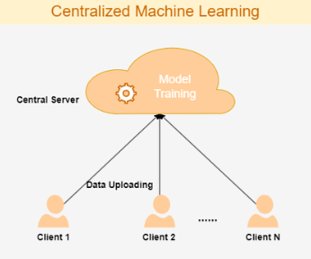

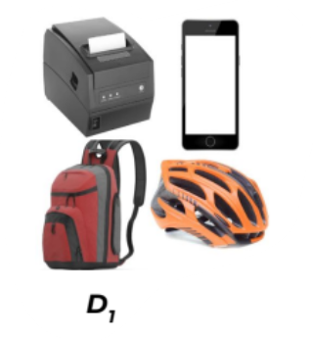
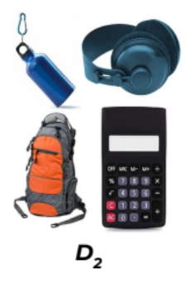
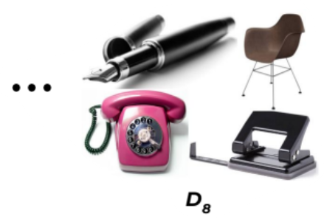
Motivation
Traditional Machine Learning requires users to upload their data to the centralized server giving user no control over how his data is used.
Data Privacy & Security
High Communication Costs
Resource Constraints
Single Point of Failure
Network Instability
Data Aggregation
[1]Mawela, Chamith & Ben Issaid, Chaouki & Bennis, Mehdi. (2024). A Web-Based Solution for Federated Learning with LLM-Based Automation. 10.48550/arXiv.2408.13010.
Notes:
To overcome the privacy challenges, the Federated Learning paradigm was proposed by Google in the year. 2017.

Slide 4
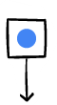
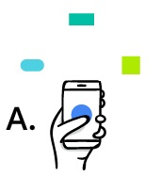
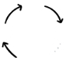
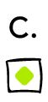
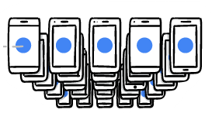

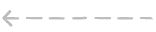
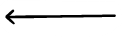
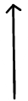
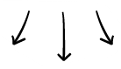
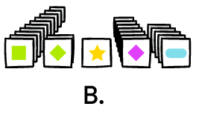


Federated Learning
Unlike traditional ML centralized data uploads here only weights exchange
Model(weight)
Aggregation
Privacy-Centric: Eliminates sensitive data exchange.
Weight Exchange: Shares model weights instead of raw local data.
Distributed Architecture: Leverages decentralized learning across multiple clients.
A: Local training on your device.
B: Combining data weights from many devices.
C: Updating the global model for everyone
Notes:
Google-2017-Federated Learning (FL) is a distributed learning paradigm that can learn a global model from decentralised data without exchanging sensitive data across the clients.
Federated Learning models are trained by exchanging weights rather than sharing data addressing sensitive data privacy and data access issues.

Slide 5
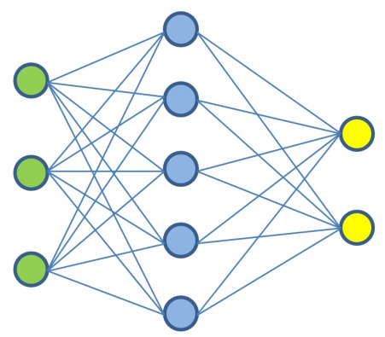
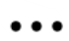
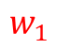
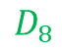

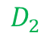
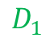
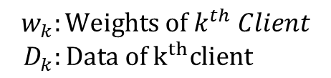
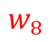
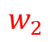
Fed Avg (Federated Averaging)
$$w=\sum_{k=1}^{K}{\frac{\left|D_{k}\right|}{\left|D\right|}w_{k}}$$
Traditional FL
Global Model
4
3
1
1.Sharing weights to clients
2.Local training
3.Sharing weights to Global model
4.Weight averaging
3
1
3
1
Local Model
2
$$w_{1}$$
2
$$w_{2}$$
2
$$w_{8}$$
$$D_{2}$$
$$D_{8}$$
$$w_{k}:Weights of k^{th} Client$$
${ D}_{k}:Data of k^{th}client$
$$D_{1}$$
[2]McMahan et al. "Communication-efficient learning of deep networks from decentralized data". In: PMLR,2017
Notes:
Traditional Federated Learning optimization involve local client training on the local datasets for a fixed number of epochs.
The local clients then upload the model weights to the central server, where the weights are averaged to form a global model whose parameters are shared with the local clients.
This method is known as FedAvg.

Slide 6
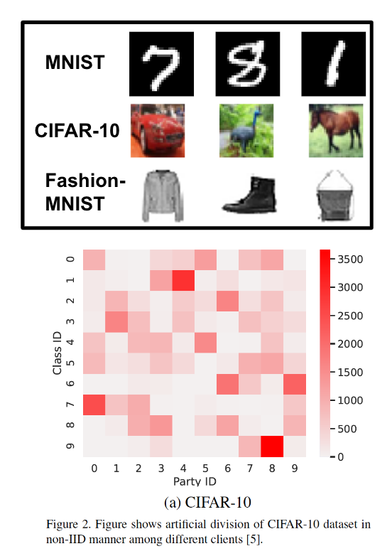
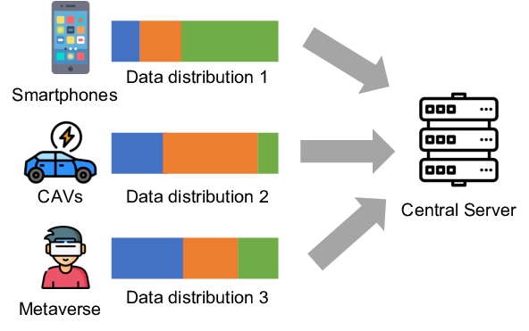
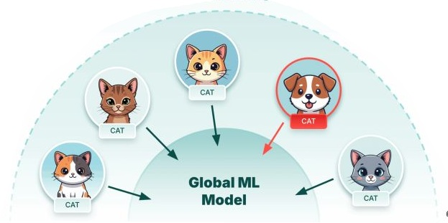
Problem Statement
Artificial Division of Existing Datasets:
Domain shift
Statistical Heterogeneity:
FedAvg suffer from non-convergence
Averaging Dilemma: Outlier features
Communication Bottlenecks: Centralized aggregation cause congestion
Outlier
Objective: To develop algorithms robust to
statistical heterogeneity with faster convergence
and lower communication costs.
Notes:
Artificial Division of Existing Datasets
Most previous works applied the Federated algorithm on a single dataset distributed among the clients artificially.
Statistical Heterogeneity
FedAvg can have convergence issue [1] if the data distribution among the clients is non-I.I.D.
Personalized Learning
FedAvg does not generalize [2] well for client with local distribution that is very different from global distribution.

Slide 7
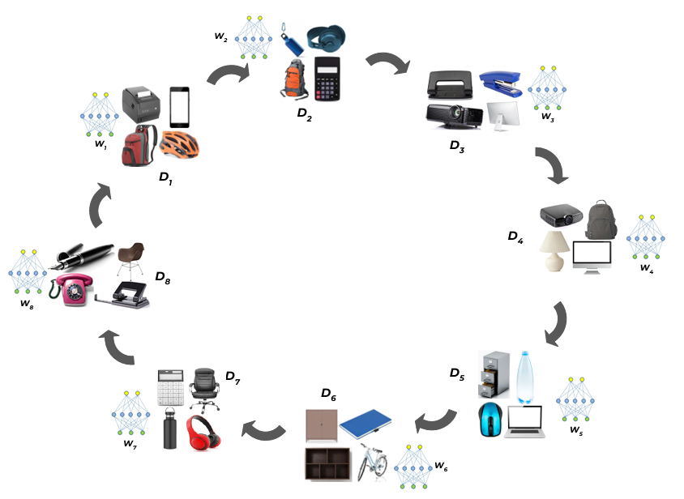
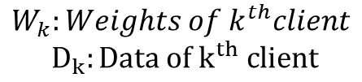
Fed-Cyclic
Single model is rotated across the clients.
A client trains the model received and sends the updated model to the next client.
Global server can be involved to coordinate passing of the model from one client to another.
Communicationally Efficient
$$W_{k}:Weights of k^{th}client$$
$$D_{k}:Data of k^{th} client$$
[3]Jain, Shreyansh, and Koteswar Rao Jerripothula. “Federated Learning for Commercial Image Sources.” 2023 IEEE/CVF Winter Conference on Applications of Computer Vision (WACV), IEEE, 2023

Slide 8

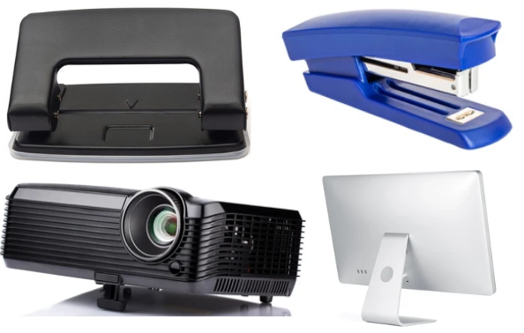





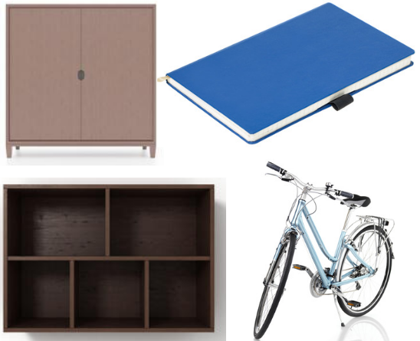
D₂
W₁
D₃
W₁
D₁
D₄
D₈
D₇
D₅
D₆
$$W_{k}:Weights of k^{th}client$$
$$D_{k}:Data of k^{th} client$$
Notes:
Lets discuss about algorithm

Slide 9
W₂
W₂
D₂
W₁
D₃
D₁
D₄
D₈
D₇
D₅
D₆
$$W_{k}:Weights of k^{th}client$$
$$D_{k}:Data of k^{th} client$$

Slide 10
W₂
D₂
W₃
W₃
W₁
D₃
D₁
D₄
D₈
D₇
D₅
D₆
$$W_{k}:Weights of k^{th}client$$
$$D_{k}:Data of k^{th} client$$

Slide 11
W₂
D₂
W₃
W₁
D₃
D₁
D₄
W₄
D₈
D₇
D₅
D₆
$$W_{k}:Weights of k^{th}client$$
$$D_{k}:Data of k^{th} client$$

Slide 12
W₂
D₂
W₃
W₁
D₃
D₁
D₄
D₈
W₄
D₇
D₅
D₆
W₅
$$W_{k}:Weights of k^{th}client$$
$$D_{k}:Data of k^{th} client$$

Slide 13
W₂
D₂
W₃
W₁
D₃
D₁
D₄
D₈
W₄
D₇
D₅
D₆
W₅
W₆
$$W_{k}:Weights of k^{th}client$$
$$D_{k}:Data of k^{th} client$$

Slide 14
W₂
D₂
W₃
W₁
D₃
D₁
D₄
D₈
W₄
D₇
D₅
D₆
W₅
W₇
W₆
$$W_{k}:Weights of k^{th}client$$
$$D_{k}:Data of k^{th} client$$

Slide 15
W₂
D₂
W₃
W₁
D₃
D₁
D₄
D₈
W₄
W₈
D₇
D₅
D₆
W₅
W₇
W₆
$$W_{k}:Weights of k^{th}client$$
$$D_{k}:Data of k^{th} client$$

Slide 16
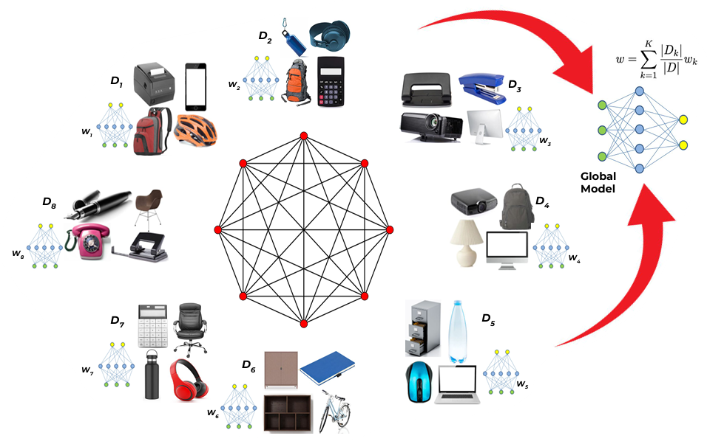
Fed-Star
Algorithm –
Shared Foundation: Every client starts with a shared global model to ensure a common understanding of the data.
Personalized Weights: Unlike standard methods, Fed-Star assigns unique weights to each client to better handle their specific data differences.
Personalization capability
$$W_{k}:Weights of k^{th}client$$
$$D_{k}:Data of k^{th} client$$
Notes:
Enhanced Personalization: By incorporating these outlier features before reaching the global server, the resulting global model achieves significantly better personalization capabilities.
Client-Side Pre-aggregation: Before global syncing, local clients exchange and pre-aggregate model weights using a star topology.
Statistical Heterogeneity: This pre-aggregation step is specifically designed to mitigate challenges arising from diverse and non-IID data across different clients.
Feature Cross-Testing: Clients test peer models on their own local data to identify and prioritize learning outlier features they might have otherwise missed.

Slide 17
Fed-Star
Smart Aggregation: It uses a "pre-aggregation" step that identifies and prioritizes important features across the network.
Star Topology: Information moves in an "all-to-all" style, allowing the model to capture unique "outlier" details that others miss
$$W_{k}:Weights of k^{th}client$$
$$D_{k}:Data of k^{th} client$$
Notes:
Client-Side Pre-aggregation: Before global syncing, local clients exchange and pre-aggregate model weights using a star topology.
Statistical Heterogeneity: This pre-aggregation step is specifically designed to mitigate challenges arising from diverse and non-IID data across different clients.
Feature Cross-Testing: Clients test peer models on their own local data to identify and prioritize learning outlier features they might have otherwise missed.
Enhanced Personalization: By incorporating these outlier features before reaching the global server, the resulting global model achieves significantly better personalization capabilities.

Slide 18









Dataset
Inspiration: Modelled after the Office-31 dataset, featuring common office objects like keyboards, monitors, and laptops.
Scale: Total of 23,326 images across 31 distinct categories.
Source: Data gathered from 8 different image-hosting websites, representing 8 unique clients.
Purpose: Designed for image-classification tasks with a focus on addressing Domain Shift.
[3]Jain, Shreyansh, and Koteswar Rao Jerripothula. “Federated Learning for Commercial Image Sources.” 2023 IEEE/CVF Winter Conference on Applications of Computer Vision (WACV), IEEE, 2023
Notes:
We collect images from different commercial image-sources and develop a real-world dataset that truly reflects a federated learning setup.
real-world dataset inspired from the Office-31 . for the task of image-classification

Slide 19
Results
Image classification performed on our dataset.
Method | Accurancy | Weighted F1 | Macro F1
FedAvg | 89.11% | 88.98% | 88.47%
Fed-Cyclic | 91.15% | 90.89% | 90.33%
Fed-Star | 91.72% | 91.17% | 90.58%
Method | Local Epoch(E) | Period(P) | Global Rounds®
FedAvg | 3 | - | 250
Fed-Cyclic | 3 | - | 150
Fed-Star | 3 | 2 | 50
[2] McMahan et al. "Communication-efficient learning of deep networks from decentralized data". In: PMLR,2017
[3]Jain, Shreyansh, and Koteswar Rao Jerripothula. “Federated Learning for Commercial Image Sources.” 2023 IEEE/CVF Winter Conference on Applications of Computer Vision (WACV), IEEE, 2023

Slide 20
Results
Fed-Star outperforms all the local models trained using traditional ML method and baselines and Fed-Cyclic on different sources demonstrating Personalized Learning.
Dataset Source | Model | Test Accuracy
123rf | Local Model | 85.51%
 | FedAvg | 83.79%
 | Fed-Cyclic | 86.38%
 | Fed-Star | 88.90%
Adobe Stock | Local Model | 92.43%
 | FedAvg | 91.46%
 | Fed-Cyclic | 94.52%
 | Fed-Star | 94.96%
Alamy | Local Model | 86.84%
 | FedAvg | 87.32%
 | Fed-Cyclic | 88.90%
 | Fed-Star | 90.14%
CanStockPhotos | Local Model | 89.53%
 | FedAvg | 89.20%
 | Fed-Cyclic | 90.40%
 | Fed-Star | 91.68%
Dataset Source | Model | Test Accuracy
Depositphotos | Local Model | 98.07%
 | FedAvg | 96.95%
 | Fed-Cyclic | 97.91%
 | Fed-Star | 98.33%
Getty Images | Local Model | 89.35%
 | FedAvg | 90.13%
 | Fed-Cyclic | 92.72%
 | Fed-Star | 93.87%
iStock | Local Model | 85.71%
 | FedAvg | 83.72%
 | Fed-Cyclic | 84.89%
 | Fed-Star | 86.47%
Shutterstock | Local Model | 89.45%
 | FedAvg | 89.60%
 | Fed-Cyclic | 91.56%
 | Fed-Star | 92.11%

Slide 21
Conclusion
Real-World Data: Replaced artificial data with a large-scale commercial dataset to reflect true domain shifts .
Fed-Cyclic (Efficiency): Optimized for low-resource environments using a sequential topology that reduces communication overhead.
Fed-Star (Accuracy): Achieved peak performance through a star-based topology that prioritizes personalized learning and outlier detection.
Scalable Privacy: Both models outperform traditional baselines (FedAvg) in heterogeneous, privacy-sensitive environments.
Notes:
Fed cyc--computationally inexpensive, robust to statistical heterogeneity , faster convergence than FedAvg, better personalized global model
Fed star--higher accuracy than baselines, pre-aggregation decreases the reliance on the global server , prioritizes learning of generalized and outlier
features which results in better personalization capabilities of the global model
---The algorithm is computationally inexpensive as the parameters of only one client is passed to the next at any given time.
The algorithm is robust to statistical heterogeneity as every client gets an opportunity to train the global model on its local data.
It has faster convergence than FedAvg. While being simple to implement, it attains higher accuracy and creates better personalized global model.
---Fed-Star attains higher accuracy than baselines.
The pre-aggregation step among clients decreases the reliance on the global server for convergence.
The Fed-Star algorithm, trains a model that prioritizes learning of generalized and outlier
features which results in better personalization capabilities of the global model.

Slide 22
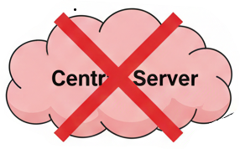
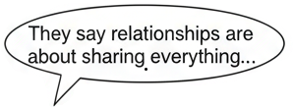

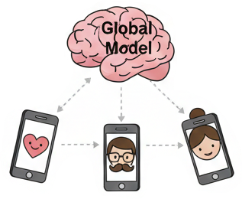

Future work - Federated Learning in Modern Dating
A Match Made in Privacy:
Optimizing Heart-to-Heart Connections without Server-to-Server Data Transfers
The Privacy Paradox
Decentralized Romance
The Goal: Stop the "toxic relationship" with central servers by using Federated Learning to find your soulmate without leaking your private data or suffering from network instability
But *we* share just weight & gradients! No privacy leaks,
No commitment issues!
#Federated Learning
Notes:
How do you find "The One" without a central server knowing "The Everything"?
Moving from Cloud-based matching to On-Device intuition.

Slide 23
Thank You

